Slide 1
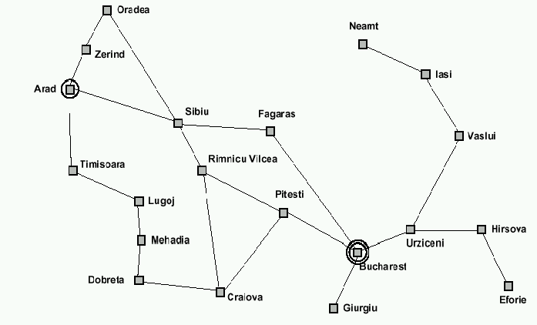
Recall: breadth-first search, step by step

Slide 2
Implementation of search algorithms
Function General-Search(problem, Queuing-Fn) returns a solution, or failure
nodes ← make-queue(make-node(initial-state[problem]))
loop do
if nodes is empty then return failure
node ← Remove-Front(nodes)
if Goal-Test[problem] applied to State(node) succeeds then return node
nodes ← Queuing-Fn(nodes, Expand(node, Operators[problem]))
end
Queuing-Fn(queue, elements) is a queuing function that inserts a set of elements into the queue and determines the order of node expansion. Varieties of the queuing function produce varieties of the search algorithm.

Slide 3
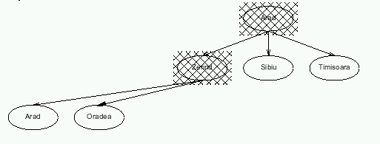
Recall: breath-first search, step by step

Slide 4
Breadth-first search
Node queue: initialization
# state depth path cost parent #
1 Arad 0 0 --

Slide 5
Breadth-first search
Node queue: add successors to queue end; empty queue from top
# state depth path cost parent #
1 Arad 0 0 --
2 Zerind 1 1 1
3 Sibiu 1 1 1
4 Timisoara 1 1 1

Slide 6
Breadth-first search
Node queue: add successors to queue end; empty queue from top
# state depth path cost parent #
1 Arad 0 0 --
2 Zerind 1 1 1
3 Sibiu 1 1 1
4 Timisoara 1 1 1
5 Arad 2 2 2
6 Oradea 2 2 2
(get smart: e.g., avoid repeated states like node #5)

Slide 7
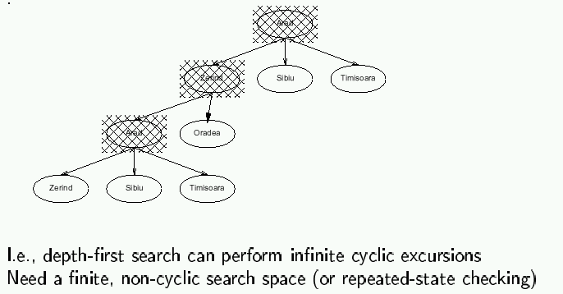
Depth-first search

Slide 8
Depth-first search
Node queue: initialization
# state depth path cost parent #
1 Arad 0 0 --

Slide 9
Depth-first search
Node queue: add successors to queue front; empty queue from top
# state depth path cost parent #
2 Zerind 1 1 1
3 Sibiu 1 1 1
4 Timisoara 1 1 1
1 Arad 0 0 --

Slide 10
Depth-first search
Node queue: add successors to queue front; empty queue from top
# state depth path cost parent #
5 Arad 2 2 2
6 Oradea 2 2 2
2 Zerind 1 1 1
3 Sibiu 1 1 1
4 Timisoara 1 1 1
1 Arad 0 0 --

Slide 11
Last time: search strategies
Uninformed: Use only information available in the problem formulation
  Breadth-first
  Uniform-cost
  Depth-first
  Depth-limited
  Iterative deepening
Informed: Use heuristics to guide the search
  Best first:
  Greedy search
  A* search

Slide 12
Last time: search strategies
Uninformed: Use only information available in the problem formulation
  Breadth-first
  Uniform-cost
  Depth-first
  Depth-limited
  Iterative deepening
Informed: Use heuristics to guide the search
  Best first:
  Greedy search -- queue first nodes that maximize heuristic “desirability” based on estimated path cost from current node to goal;
  A* search – queue first nodes that minimize sum of path cost so far and estimated path cost to goal.

Slide 13
This time
Iterative improvement
Hill climbing
Simulated annealing

Slide 14
Iterative improvement
In many optimization problems, path is irrelevant;
the goal state itself is the solution.
Then, state space = space of “complete” configurations.
Algorithm goal:
- find optimal configuration (e.g., TSP), or,
- find configuration satisfying constraints (e.g., n-queens)
In such cases, can use iterative improvement algorithms: keep a single “current” state, and try to improve it.

Slide 15
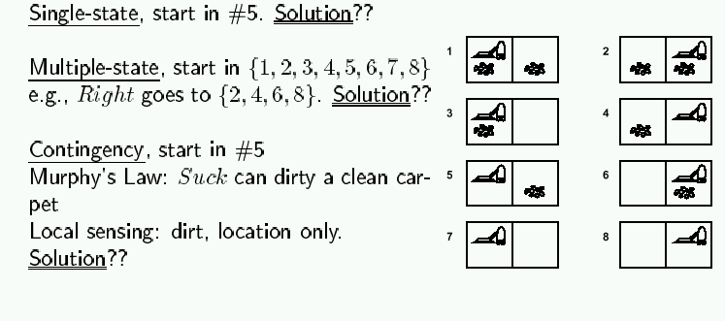
Iterative improvement example: vacuum world
Simplified world: 2 locations, each may or not contain dirt,
each may or not contain vacuuming agent.
Goal of agent: clean up the dirt.
If path does not matter, do not need to keep track of it.

Slide 16
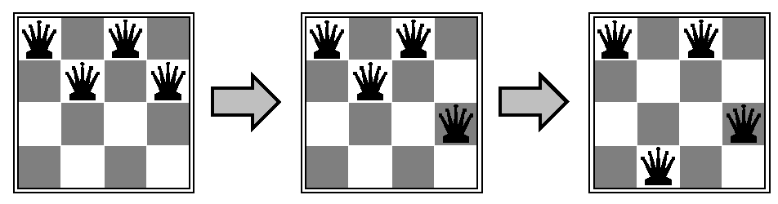
Iterative improvement example: n-queens
Goal: Put n chess-game queens on an n x n board, with no two queens on the same row, column, or diagonal.
Here, goal state is initially unknown but is specified by constraints that it must satisfy.

Slide 17
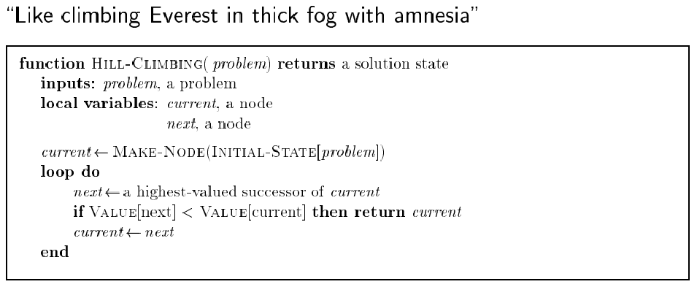
Hill climbing (or gradient ascent/descent)
Iteratively maximize “value” of current state, by replacing it by successor state that has highest value, as long as possible.

Slide 18
Hill climbing
Note: minimizing a “value” function v(n) is equivalent to maximizing –v(n),
thus both notions are used interchangeably.
Notion of “extremization”: find extrema (minima or maxima) of a value function.

Slide 19
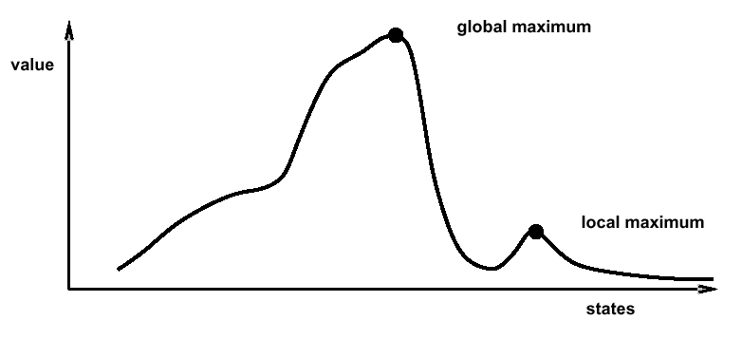
Hill climbing
Problem: depending on initial state, may get stuck in local extremum.

Slide 20
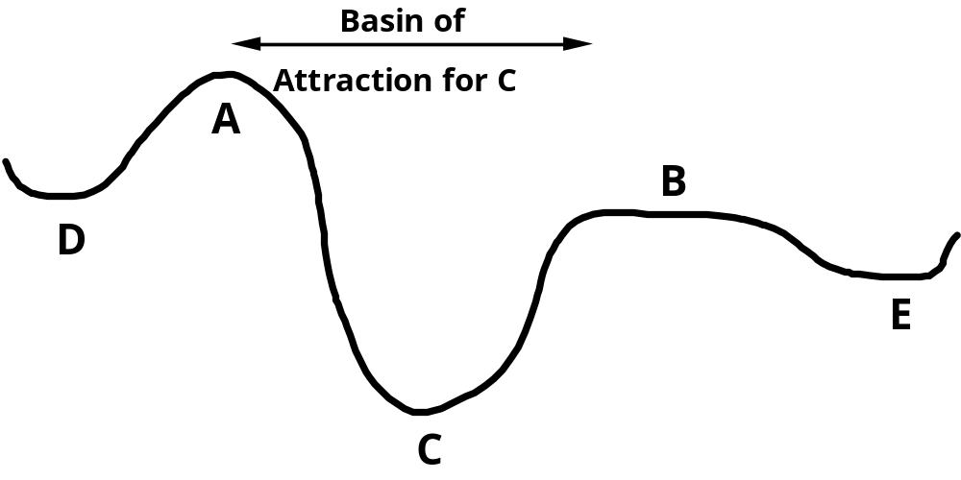
Minimizing energy
Let’s now change the formulation of the problem a bit, so that we can employ new formalism:
- let’s compare our state space to that of a physical system that is subject to natural interactions,
- and let’s compare our value function to the overall potential energy E of the system.
On every updating we have ΔE ≤ 0
Hence the dynamics of the system tend to move E toward a minimum.
We stress that there may
be different such states —
they are local minima.
Global minimization is
not guaranteed.

Slide 21
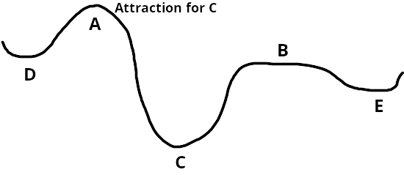
Boltzmann machines
h
The Boltzmann Machine of
Hinton, Sejnowski, and Ackley (1984)
uses simulated annealing to escape local minima.
To motivate their solution, consider how one might get a ball-bearing traveling along the curve to "probably end up" in the deepest minimum. The idea is to shake the box "about h hard" — then the ball is more likely to go from D to C than from C to D. So, on average, the ball should end up in C's valley.

Slide 22
Simulated annealing: basic idea
From current state, pick a random successor state;
If it has better value than current state, then “accept the transition,” that is, use successor state as current state;
Otherwise, do not give up, but instead flip a coin and accept the transition with a given probability (that is lower as the successor is worse).
So we accept to sometimes “un-optimize” the value function a little with a non-zero probability.

Slide 23
Boltzmann’s statistical theory of gases
In the statistical theory of gases, the gas is described not by a deterministic dynamics, but rather by the probability that it will be in different states.
The 19th century physicist Ludwig Boltzmann developed a theory that included a probability distribution of temperature (i.e., every small region of the gas had the same kinetic energy).
Hinton, Sejnowski and Ackley’s idea was that this distribution might also be used to describe neural interactions, where low temperature T is replaced by a small noise term T (the neural analog of random thermal motion of molecules). While their results primarily concern optimization using neural networks, the idea is more general.

Slide 24
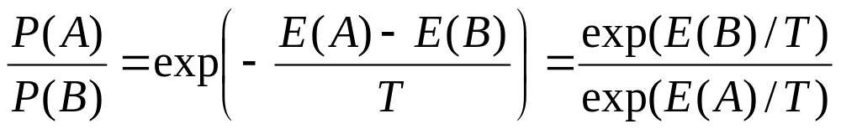
Boltzmann distribution
At thermal equilibrium at temperature T, the
Boltzmann distribution gives the relative
probability that the system will occupy state A vs.
state B as:
where E(A) and E(B) are the energies associated with states A and B.

Slide 25
Simulated annealing
Kirkpatrick et al. 1983:
Simulated annealing is a general method for making likely the escape from local minima by allowing jumps to higher energy states.
The analogy here is with the process of annealing used by a craftsman in forging a sword from an alloy.
He heats the metal, then slowly cools it as he hammers the blade into shape.
  If he cools the blade too quickly the metal will form patches of different composition;
  If the metal is cooled slowly while it is shaped, the constituent metals will form a uniform alloy.

Slide 26
Simulated annealing in practice
set T
optimize for given T
lower T (see Geman & Geman, 1984)
repeat

Slide 27
Simulated annealing in practice
set T
optimize for given T
lower T (see Geman & Geman, 1984)
repeat
Geman & Geman (1984): if T is lowered sufficiently slowly (with respect to the number of iterations used to optimize at a given T), simulated annealing is guaranteed to find the global minimum.
Caveat: this algorithm has no end (Geman & Geman’s T decrease schedule is in the 1/log of the number of iterations, so, T will never reach zero), so it may take an infinite amount of time for it to find the global minimum.

Slide 28
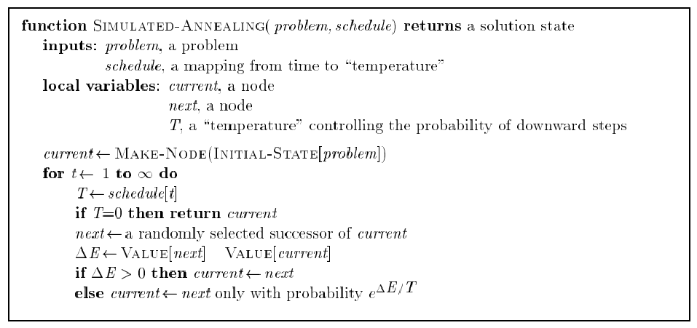
Simulated annealing algorithm
Idea: Escape local extrema by allowing “bad moves,” but gradually decrease their size and frequency.
Note: goal here is to
maximize E.
-

Slide 29
Simulated annealing algorithm
Idea: Escape local extrema by allowing “bad moves,” but gradually decrease their size and frequency.
Algorithm when goal
is to minimize E.
-
<
-

Slide 30
Note on simulated annealing: limit cases
Boltzmann distribution: accept “bad move” with ΔE<0 (goal is to maximize E) with probability P(ΔE) = exp(ΔE/T)
If T is large: ΔE < 0
ΔE/T < 0 and very small
exp(ΔE/T) close to 1
accept bad move with high probability
If T is near 0: ΔE < 0
ΔE/T < 0 and very large
exp(ΔE/T) close to 0
accept bad move with low probability

Slide 31
Note on simulated annealing: limit cases
Boltzmann distribution: accept “bad move” with ΔE<0 (goal is to maximize E) with probability P(ΔE) = exp(ΔE/T)
If T is large: ΔE < 0
ΔE/T < 0 and very small
exp(ΔE/T) close to 1
accept bad move with high probability
If T is near 0: ΔE < 0
ΔE/T < 0 and very large
exp(ΔE/T) close to 0
accept bad move with low probability
Random walk
Deterministic
down-hill

Slide 32
Summary
Best-first search = general search, where the minimum-cost nodes (according to some measure) are expanded first.
Greedy search = best-first with the estimated cost to reach the goal as a heuristic measure.
- Generally faster than uninformed search
- not optimal
- not complete.
A* search = best-first with measure = path cost so far + estimated path cost to goal.
- combines advantages of uniform-cost and greedy searches
- complete, optimal and optimally efficient
- space complexity still exponential

Slide 33
Summary
Time complexity of heuristic algorithms depend on quality of heuristic function. Good heuristics can sometimes be constructed by examining the problem definition or by generalizing from experience with the problem class.
Iterative improvement algorithms keep only a single state in memory.
Can get stuck in local extrema; simulated annealing provides a way to escape local extrema, and is complete and optimal given a slow enough cooling schedule.

